Slide 1


Network & System Administration
Disaster Recovery and Business Continuity

Slide 2
Week | 10th Week
Day
Duration | 4hrs
Agenda
TIME | TOPIC & ACTIVITY | CPMPLETED-
30 Mins | IT Service Management | Yes/No
60 Mins | IT service frameworks (e.g., ITIL) | Yes/No
15 Mins | Break | Yes/No
45 Mins | Incident management and service request fulfillment | Yes/No
30 Mins | Q&A Session on lesson learnt | Yes/No
15 Mins | Break | Yes/No
60 Mins | Service-level agreements (SLAs) and service catalogs | Yes/No
15 Mins | Group Discussion | Yes/No

Slide 3
Learning Objectives
10.0 IT Service Management
10.1 IT Service Frameworks (e.g., ITIL)
10.2 Incident Management and Service Request Fulfillment
10.3 Service-level Agreements (SLAs) and Service Catalogs

Slide 4
10.0 IT Service Management

Slide 5

What is an IT Service Management
The process of organizing, implementing, maintaining, and optimizing information technology services to satisfy user needs and assist businesses in achieving their objectives is known as IT service management, or ITSM.

Slide 6
10.1 IT service frameworks (e.g., ITIL)

Slide 7
Introduction to ITIL
ITIL, which stands for Information Technology Infrastructure Library, is a widely recognized framework for IT Service Management (ITSM). It provides a set of best practices and guidelines for managing IT services efficiently and effectively. ITIL helps organizations align their IT services with their business goals and deliver value to their customers.
History: ITIL was originally developed by the UK government in the 1980s as a collection of best practices for IT service management. It has since evolved and gained widespread adoption worldwide
IT services refer to the various technology-related services and solutions that organizations provide to their users, customers, or employees to support their business operations and goals. These services encompass a wide range of activities, from hardware and software support to network management, cybersecurity, application development, and more. Essentially, IT services are the means by which technology is delivered and utilized within an organization IT Service Management (ITSM) is a discipline or framework that focuses on effectively and efficiently managing these IT services to ensure they meet the needs of the organization and its customers. It involves planning, designing, delivering, operating, and controlling IT services, with a primary emphasis on aligning IT with the business objectives. ITSM helps organizations streamline their IT operations, enhance service quality, and maintain a customer-centric approach

Slide 8
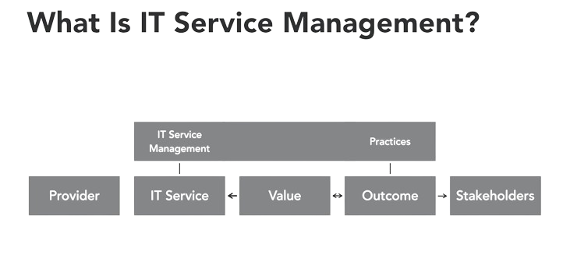

Slide 9
Implementing ITIL
Implementing ITIL (Information Technology Infrastructure Library) within your organization can have several significant benefits, impacting various aspects of your IT service delivery and overall business operations. Here's what ITIL can mean for your organization:
Improved Service Quality Alignment with Business Goals
Efficient Resource Utilization
Enhanced Customer Satisfaction
Effective Change Management
Better Problem Resolution
Clearer Roles and Responsibilities Cost Control / Risk Management Compliance and Governance / Continuous Improvement / IT Staff Development

Slide 10
ITIL Framework
Service Strategy: This publication focuses on the high-level strategy and planning aspects of IT service management. It helps organizations align their IT services with their overall business goals and objectives. Key topics covered in this book include service portfolio management, demand management, financial management for IT services, and strategies for achieving business outcomes through IT.
1
Service Design: The Service Design publication provides guidance on designing IT services that meet the needs of the business and customers. It covers topics such as service level management, service catalog management, capacity management, availability management, and IT service continuity management. The goal is to create services that are both efficient and effective
2
Service Transition: This publication deals with the processes and activities involved in transitioning new or changed services into the live environment. It includes change management, release and deployment management, service asset and configuration management, knowledge management, and more. The focus is on ensuring that changes are implemented smoothly and without disrupting existing services
3
Service Operation: Service Operation is all about the day-to-day management and delivery of IT services. This publication covers incident management, problem management, event management, request fulfillment, access management, and other operational processes. The aim is to provide reliable and efficient services to users and customers
4
Continual Service Improvement (CSI): The CSI publication emphasizes the importance of continuous improvement in IT service management. It provides a framework for organizations to regularly assess their services, processes, and performance. Key components include the Deming Cycle (Plan-Do-Check-Act), service measurement and reporting, and techniques for identifying areas for improvement.
5

Slide 11
10.2 Incident management and service request fulfillment

Slide 12
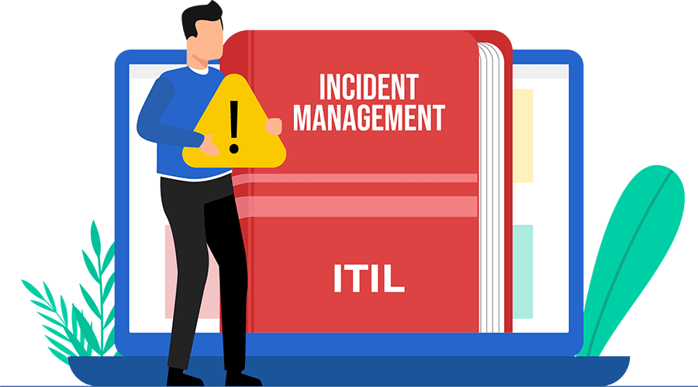
Incident Management
The process of locating, evaluating, and resolving problems in order to minimize their negative effects on business operations and promptly return regular service operation is known as incident management. An unforeseen disruption to an IT service or a decline in the quality of an IT service is referred to in this context as a "incident".

Slide 13
Key Objectives:
resume Services Quickly: In order to minimise business disturbance, the main objective is to quickly resume regular service functioning.
Detection and Recording of Incidents: Make sure that every occurrence is reported and documented in a centralised system.
Classification and Prioritisation: To prioritise resolution efforts, ascertain the impact and severity of issues.
Investigation and Diagnosis: the incident to determine its underlying cause.
Resolution and Recovery: To restore service, apply a patch or workaround.

Slide 14
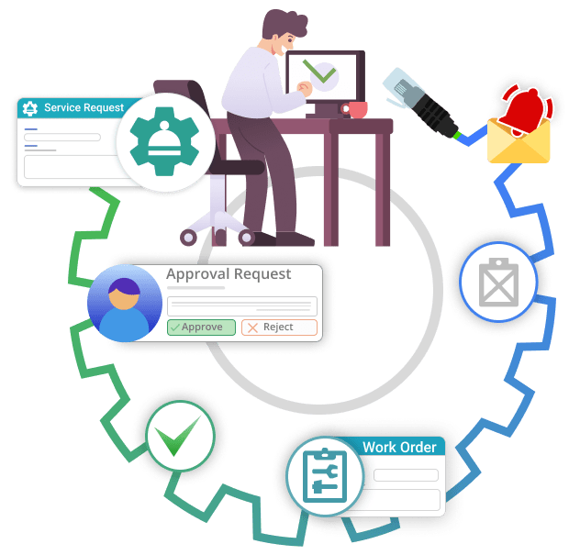
Service Request Fulfilments
The management and completion of service requests, which are essentially low-risk, predetermined requests from users for data, guidance, a standard update, or access to a service, is the focus of service request fulfilment. Because service requests are routine chores rather than interruptions, they differ from incidents.

Slide 15
Key Objectives:
Effective Processing: Respond to service requests in a timely and effective manner.
Standardisation: Consistently fulfil requests by using predetermined processes.
User Satisfaction: Verify that users are happy with the results and the fulfilment process.
Automation: To increase efficiency and decrease manual labour, automate request processing whenever it is practical.

Slide 16
Q&Q Session on Lesson learned

Slide 17
Q&Q Session
Q1: What is ITIL and why is it important?
A1: ITIL (Information Technology Infrastructure Library) is a set of best practices for IT service management. It is important because it provides a systematic approach to managing IT services, ensuring they align with the business needs, enhance service delivery, and improve customer satisfaction.
Q2: What is the purpose of the Service Strategy stage in ITIL?
A2:The Service Strategy stage aims to define the perspective, position, plans, and patterns that a service provider needs to execute to meet business outcomes and provide value to customers.

Slide 18
Q&Q Session
Q4: What is the primary goal of incident management?
A4: he primary goal of incident management is to restore normal service operation as quickly as possible and minimize the adverse impact on business operations, ensuring the best possible levels of service quality and availability.
Q5: What is the difference between an incident and a service request?
A5: An incident is an unplanned interruption to an IT service or a reduction in the quality of an IT service, while a service request is a user request for information, advice, a standard change, or access to an IT service.

Slide 19
10.3 Service-Level Agreements (SLAs) and Service Catalogs

Slide 20
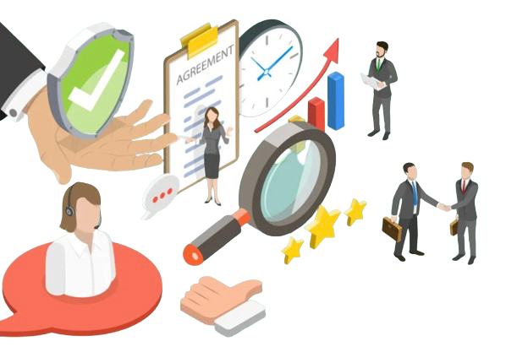
Service-Level Agreements (SLAs)
Service-Level Agreements (SLAs) are legally binding contracts that specify obligations, assurances, and the expected level of service between clients and service providers. To make sure that everyone is aware of the service standards and expectations, SLAs are essential.

Slide 21
Key Components
Service Description
Performance Metrics
Responsibilities
Monitoring and Reporting
Penalties and Remedies
Security and Compliance
Dispute Resolution
Change Management
Termination

Slide 22
Creating an Effective SLA
Stakeholder Involvement: Engage all relevant stakeholders in drafting the SLA to ensure comprehensive coverage and mutual agreement.
Clear and Specific Language: Use precise language to avoid ambiguities.
Realistic and Achievable Targets: Set realistic performance metrics that can be consistently met.
Regular Reviews: Periodically review and update the SLA to reflect changes in service requirements or business conditions.
Effective Communication: Ensure open lines of communication between the service provider and client to address issues promptly.

Slide 23
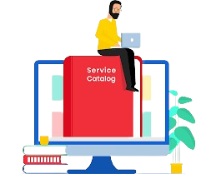
Architectural Considerations
A service catalogue is an extensive inventory or archive of every IT service that a company offers to its clients. Each service's description is usually included, along with other important elements like pricing, request procedures, support information, and Service Level Agreements (SLAs). To guarantee high-quality service delivery and to set clear expectations, SLAs must be integrated into service catalogues.

Slide 24
Key Components
Service Description
Service Levels and SLAs
Request Processes
Pricing and Costing
Roles and Responsibilities
Contact Information

Slide 25
Group Discussion
IT Service Management
IT service frameworks (e.g., ITIL)
Incident management and service request fulfillment
Service-level agreements (SLAs) and service catalogs

